Slide 1



Slide 2


Slide 3


Slide 4

Let’s start by defining “Burning Out”
A little about me

Slide 5

Burning Out is when the effort exceeds the reward

Slide 6

A little about me

Slide 7
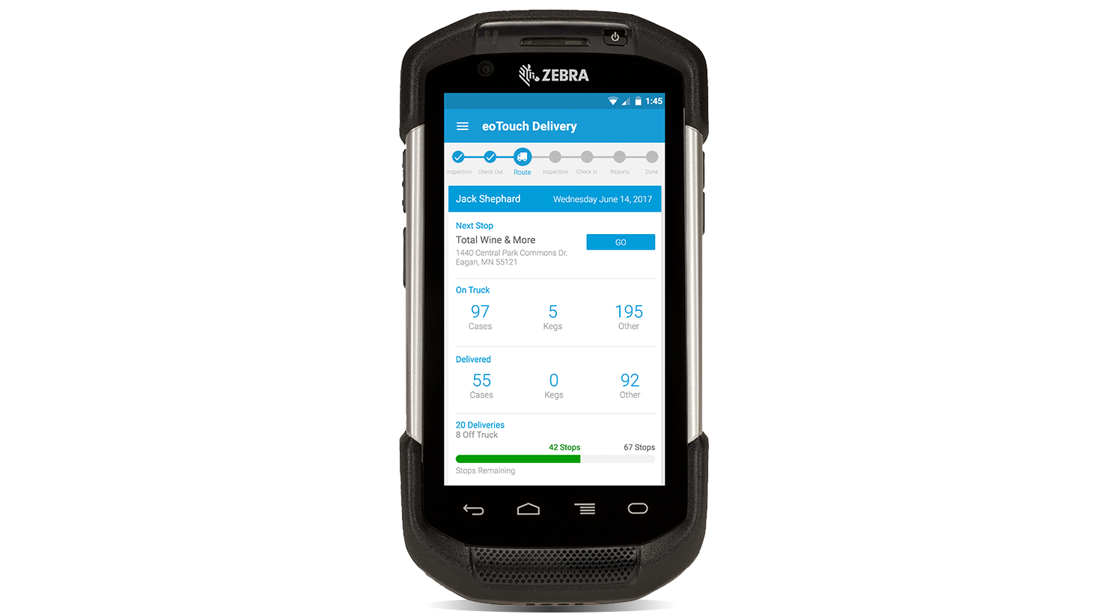

A little about me

Slide 9


My burnout story

Slide 10

Stats on burnout
23% feel burned out often
44% feel burned out sometimes
33% of Workers have never dealt with burnout
https://www.gallup.com/workplace/237059/employee-burnout-part-main-causes.aspx

Slide 11

2/3rds
DEAL WITH
BURNOUT
Notes:
t

Slide 12

The Effects of Burnout
63% more likely to take a sick day
https://www.gallup.com/workplace/237059/employee-burnout-part-main-causes.aspx
Notes:
t

Slide 13
The Effects of Burnout
63% more likely to take a sick day
1/2 as likely to discuss performance goals
https://www.gallup.com/workplace/237059/employee-burnout-part-main-causes.aspx
Notes:
t

Slide 14
The Effects of Burnout
63% more likely to take a sick day
1/2 as likely to discuss performance goals
23% more likely to visit the emergency room
https://www.gallup.com/workplace/237059/employee-burnout-part-main-causes.aspx
Notes:
t

Slide 15
The Effects of Burnout
63% more likely to take a sick day
1/2 as likely to discuss performance goals
23% more likely to visit the emergency room
13% less confident in their performance
https://www.gallup.com/workplace/237059/employee-burnout-part-main-causes.aspx
Notes:
t

Slide 16
The Effects of Burnout
63% more likely to take a sick day
1/2 as likely to discuss performance goals
23% more likely to visit the emergency room
13% less confident in their performance
2.6 times as likely to leave current role
https://www.gallup.com/workplace/237059/employee-burnout-part-main-causes.aspx
Notes:
t

Slide 17

Some Tools in My Kit
Agile Methodology
Design Thinking
Process Improvement
Project Management
Testing Process
User Research
Horrible Coding Skills*

Slide 18
Some Tools in My Kit
Agile Methodology
Design Thinking
Process Improvement
Project Management
Testing Process
User Research
Horrible Coding Skills*

Slide 19
Design Thinking according to Wikipedia
“Design Thinking refers to the cognitive, strategic and practical processes by which design concepts (proposals for new products, buildings, machines, etc.) are developed by designers and/or design teams. Many of the key concepts and aspects of design thinking have been identified through studies, across different design domains, of design cognition and design activity.”
https://en.m.wikipedia.org/wiki/Design_thinking

Slide 20

Design Thinking is a structure of creative problem solving for tackling complex challenges

Slide 21





3 Core Stages of Design Thinking
(5 depending on who you ask ¯\_(ツ)_/¯ )
1.
Inspiration
2.
Ideation
3. Implementation
Notes:
Empathise, Define (the problem), Ideate, Prototype, and Test

Slide 22
I had to look at my life to understand what was causing my burnout

Slide 23


TOO BUSY
Reason 1
NO VOICE

Slide 24
TOO BUSY
NO VOICE
Reason 2
NO GROWTH

Slide 25

NO VOICE
Reason 3
NO GROWTH

Slide 26

The question
How do we solve these issues?

Slide 27

I came up with an idea…

Slide 28
I came up with an idea…
To read at least 1 business book a month

Slide 29

I came up with an idea…
To read at least 1 business book a month
Learning to stay inspired

Slide 30
Look at inspiration differently
Collect inspiration
You can impact culture

Slide 31

Learning to say no

Slide 32
Look at varied options
Pick the most important
You can say no

Slide 33

Continue to growing

Slide 34
It’s ok to not know
Strive to multiple outcomes
Build the right team

Slide 35
Work habits can created
Trigger > Action > Variable Reward > Invest
Apply habit forming to enterprise

Slide 36
Ideas can be infectious
Clear and can Visualize
Make things sticky for stakeholders

Slide 37
Good intentions can sour
Smart people can make mistakes
Don’t lie…

Slide 38
People rarely hear what you say
Concepts of frames
Selling ideas can be learned

Slide 39

Where am I now?

Slide 40

Where am I now?

Slide 41

Burning Out is when the effort exceeds the reward

Slide 42
Use the tools and processes you already have

Slide 43
Look at your own situation
Identify the causes (triggers/stressors)
Plan for how to handle them

Slide 44

Where do you go from here?
Slides on GitHub @ bit.ly/2MK59fJ

Slide 45



Gary Keeler
Youtube.com/c/garykeeler
@iamkeeler
Slides on GitHub @ bit.ly/2MK59fJ

